Slide 1
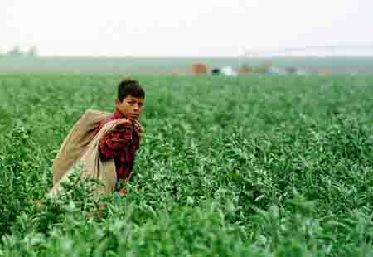
CHILD LABOR WEBQUEST
FOR CLASS 5-301

Slide 2
INTRODUCTION:
Did you know... By nineteen hundred, more than two million U.S. children worked? Children worked in factories, mines, fields, and in the streets. They picked cotton, shined shoes, sold newspapers, canned fish, made and wove fabric. The conditions in which they worked were usually horrible, with children working long hours with hardly any time to eat or rest, and for very little pay. Many children were killed by dangerous machinery. Children were forced into this situation in order to help support their families. It wasn't until 1938 when the Fair Labor Standards Act was passed that children were freed from the bondage of dangerous work.

Slide 3
BACKGROUND INFO:
The Campaign to End Child Labor
In 1900, approximately two million children were working in mills, mines, fields, factories, stores, and on city streets across the Untied States. The 1900 census, which counted workers aged 10 to 15 found that 18.2 percent of the country's children between those ages were working. This census report helped to spark a national movement to end child labor in the United States. The National Child Labor Committee was founded in 1904.
This movement argued that it was morally wrong to subject children to this kind of abuse. In addition, they argued that children were losing their childhood. They compared child labor to slavery and said that this was as great a problem as slavery. The movement also said the industrial revolution was bringing progress in wealth, education, and increased leisure time. However, it was noted that poverty was increasing right along with this progress. It turned out that progress was creating huge fortunes for a few while the rest of society only received the crumbs from the table. The extent of child labor documented by the 1900 census was chilling evidence of the failure of technological progress to produce the American Dream of a better life for all.

Slide 4
BACKGROUND INFO:
The National Child Labor Committee began to take action. The members of this committee began to see that child labor was not only damaging to the child but hurt the nation as a whole. Child labor itself was an obstacle to the progress of the nation and to civilization in general. They said that if it was necessary to have child labor in America, then American society was not worth saving. More importantly they began to take some very important steps to change the situation.
First, they began to document how bad the situation of child labor had become. In 1908, they hired Lewis Hine, a photographer, to take pictures of children working in many different occupations in all kinds of conditions. These pictures were a powerful tool in convincing people of the evils of child labor. No longer could people deny that such conditions existed in America. The movement used these pictures in their efforts to lobby both state and national law-making bodies to enact legislation to address the problem of child labor. In addition, to arguing for an end to child labor, the movement also argued for improved working conditions for all workers and for compulsory education for children.

Slide 5
BACKGROUND INFO:
The first federal legislation concerning child labor was passed in 1916. Although, effective federal child labor laws would not really be in place until the late 1930s, this early legislation convinced Americans of the evils of child labor and ended much of the opposition to the prohibiting of child labor. It would take more time to convince the courts that legislating against child labor was not interfering with personal freedoms and was constitutional. In 1938, the Fair Labor Standards Act was based and this effectively ended the practice of child labor by not allowing a company to sell its products across state boundaries if they used child labor to produce it. This time the courts agreed with the law and said it was constitutional.
However, the National Child Labor Committee did not die. It is still active today. Although countless children and their children were saved from exploitation in mines, mills, and factories, new challenges have arisen both in the United States and abroad. There is still much work to be done and the young people today will have to be part of the solution.

Slide 6
INTRODUCTION:
This may seem a horrible tragedy of our nation's past, but young people around the world continue to toil as child laborers. Internationally, two hundred fifty million children work to help support their families or by force. A significant number of children are migrant farm workers or sweatshop workers in the United States

Slide 7
TASK:
You are part of a team where you will use your individual talents and skills to compile an informative presentation to try to persuade people to take action and reform child labor today. You will then present the project you chose (explained in the process section), and your group's ideas and discussion to the rest of the class in a mock demonstration against child labor. Through weblinks to primary sources And other resources, you will gather information to use in this project.

Slide 8
PROCESS:
Each team must produce at least one of the following products: *Creative story about child labor *A political cartoons *A poem or a song *An editorial article
2.The following questions must be answered within your final product and in your group's presentation: *Analyze the reasons for child labor in the U.S. during the Industrial Age. What are the reasons for it today? Compare the similarities and differences. *Think of a way Americans can help to abolish child labor in our country and around the world. *Determine which obstacles you would have to overcome when attempting to reform child labor today. How would you overcome them? *

Slide 9
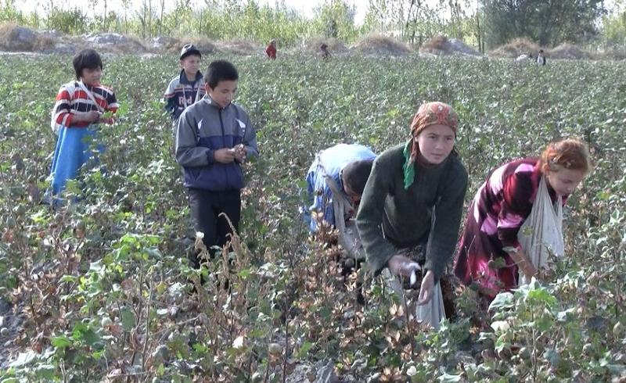
PROCESS:
For each source that you explore, you must complete an MLA format bibliography. *For each site that you visit, be sure to take notes to help you gather information for your final project, and to answer the above questions.

Slide 10
TASK:
You are part of a team where you will use your individual talents and skills to compile an informative presentation to try to persuade people to take action and reform child labor today. You will then present the project you chose (explained in the process section), and your group's ideas and discussion to the rest of the class in a mock demonstration against child labor. Through web-links to primary sources as well as through other resources, you will gather information to use in this project.

Slide 11
HELPFUL WEBSITES:
HELPFUL CHILD LABOR WEBSITES ABOUT CURRENT CHILD LABOR::
HAS ESSAYS WRITTEN BY KIDS: http://www.pbs.org/now/politics/migrantchildren.html
http://www.nbcbayarea.com/investigations/series/children-in-the-field/Children-in-the-Field-Picking-Our-Food-164796976.html
http://america.aljazeera.com/articles/2013/10/25/for-children-of-migrantworkersthefieldorthecar.html
http://ilo.org/ipec/areas/Migration_and_CL/lang--en/index.htm
http://www.scholastic.com/browse/article.jsp?id=5426
http://www.cracked.com/article_21750_5-awful-things-i-learned-as-child-laborer-in-usa.html
http://investigations.nbcnews.com/_news/2012/08/03/13106022-child-labor-small-hands-legally-picking-our-food
HOW YOU CAN HELP: http://www.hrw.org/support-care

Slide 12
HELPFUL LINKS:
CHILD LABOR IN THE PAST DURING INDUSTRIAL REVOLUTION:
http://www.eiu.edu/eiutps/childhood.php
http://www.history.com/topics/child-labor
http://www2.needham.k12.ma.us/nhs/cur/Baker_00/2002_p7/ak_p7/childlabor.html
http://www.socialwelfarehistory.com/programs/child-labor/

Slide 13
CHOCOLATE & CHILD LABOR
http://www.foodispower.org/slavery-chocolate/
http://www.thenation.com/blog/193521/your-favorite-chocolate-product-child-labor#
http://www.huffingtonpost.com/amanda-gregory/chocolate-and-child-slave_b_4181089.html

Slide 14
CREATIVE STORY:
Role One is to create a fictional story based on what you learn about child labor. You should use your writing skills to shed light on this issue that took place in the past, as well as the current situation in the US or the cocoa child labor situation. Write a first person story from the perspective of a child during the Industrial Revolution, a migrant child laborer or a child working in the cocoa industry. A general guideline is that the story should be at least two typed pages in length—no more than 12 font.

Slide 15
POLITICAL CARTOONS:
Political Cartoons are a medium used to get people to pay attention to a particular opinion or cause. They use symbols, caricatures or words to help shed light on a social or political issue. You will be creating your own cartoons that use these methods to draw attention to issues around child labor. Before you begin, you need a background on child labor in the U.S., and some examples of political cartoons.

Slide 16
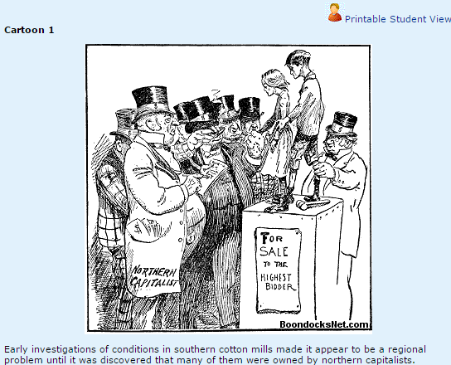
POLITICAL CARTOONS:

Slide 17
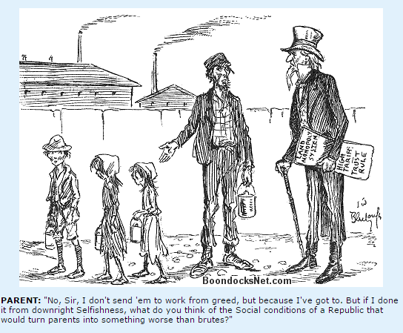
POLITICAL CARTOONS:

Slide 18
POLITICAL CARTOONS:

Slide 19
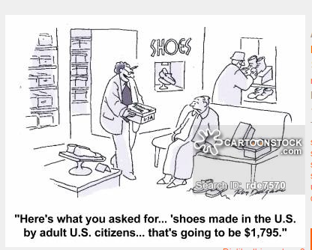
POLITICAL CARTOONS:

Slide 20
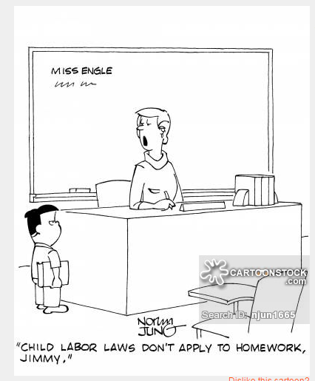
POLITICAL CARTOONS:

Slide 21
POLITICAL CARTOONS:
https://sites.google.com/a/nexgenacademy.com/more-than-laissez-faire/child-labor/child-labor-political-cartoons
http://multimedialearning.org/FreeDownloads/2012/ChildLaborCartoon_QandA.pdf

Slide 22
SONG-POEM:
Music and poetry are two very powerful means of drawing attention to a cause. You will use your creativity either in the form of three poems or one song. If you choose a song, you should prepare a melody or music to accompany it for the anti-child labor demonstration.

Slide 23
SONG-POEM
"The Flower Factory" by Florence Willkinson
Lisabetta, Marianina, Fiametta, Teresina, They are winding stems of Poses, one by one, one by one - - Little children who have never learned to play: Teresina softly crying that her fingers ache today, Tiny Fiametta nodding when the twilight slips in, gray. High above the clattering street, ambulance and fire gong beat, They sit, curling crimson petals,one by one, one by one. Lisabetta, Marianina, Fiametta, Teresina, They have never seen a rose-bush nor a dewdrop in the sun. They will dream of the vendetta, Teresina, Fiametta Of a Black Hand and a Face behind the grating; They will dream of cotton petals, endless, crimson, suffocating, Never of a wild-rose thicket nor the singing of a cricket, But the ambulance will bellow throught the wanness of their dreams, And their tired lids will flutter with the street's hysteric screams. Lisabetta, Marianina, Fiametta, Teresina, They are winding stems of roses, one by one, one by one, Let them have a long, long play-time Lord of Toil, When toil is done.

Slide 24
SONG-POEM
"Child Labor" by Benztown Bard
You going to put that boy to work, That little bit of a kid, Whose heart is out where the daisies are In the dew and the grasses hid? Going to put that boy to work, Whose soul is way out there, Dreaming of meadows and streams and bridge, And the joy of the summer air? You going to put that boy to work Who is old enough, you say, To be out helping you get along With his little pittance of pay? You going to put that boy to work

Slide 25
POEM-SONG
"Child Labor" by Benztown Bard
Who belongs to God awhile, Out in the green of the boyhood sheen Where the hills and meadows smile? May be your business, and that I'm blind, Or a fool to be butting in, But putting a kid like that to work Is an economic sin; Stunting and putting him back so long From the glory he should know In the good green spell of the wood and dell Where a kid like him should grow. You going to put that boy to work Because he can help you bear The burden of grocer and clothes and rent, And he ought to be doing his share? You going to put that boy to work, That little kid whose eyes And heart and soul are hankering for The blue of the summer skies? You going to chain him in a mill, Who all day longs and longs For the playtime life on the good green hill And the cheer of the robins' song? You’re going to put him in prison, eh, That he’ll never get out again - - For the dreams, the dreams, of the open day Can never come back to men!

Slide 26
EDITORIAL:
As an editorial writer, you have the luxury of being able to give your opinion about an issue for the newspaper. You will need to support your opinion about child labor--whether you are in favor of it, or feel it should be changed. You may write as if you were living in the early 1900's, or you can write with today's perspectives.

Slide 27
CONCLUSION:
Conclusion
Although this problem may seem too huge to fix, there are things we can all do to help. You have already helped by becoming aware of the situation and sharing what you have learned with others. You can also view these websites to learn more about organizations that fight against child labor. If you want to take action, go ahead—you are now an expert in this important issue!!!

Slide 28
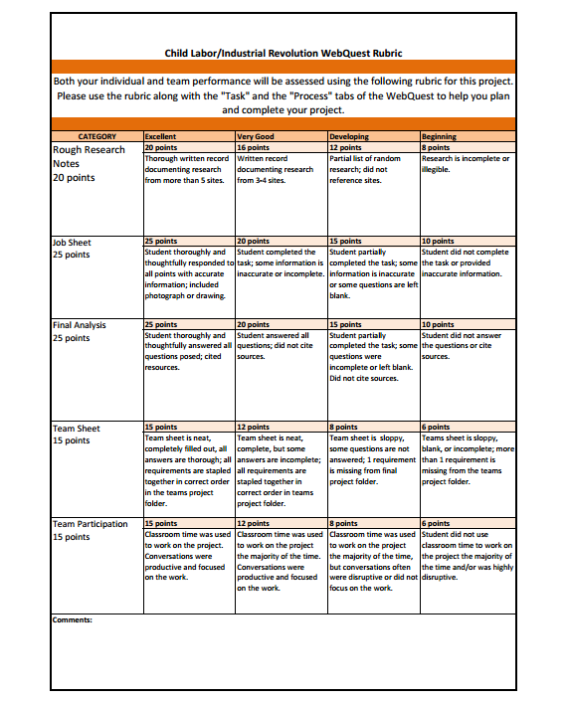
EVALUATION:

